Slide 1
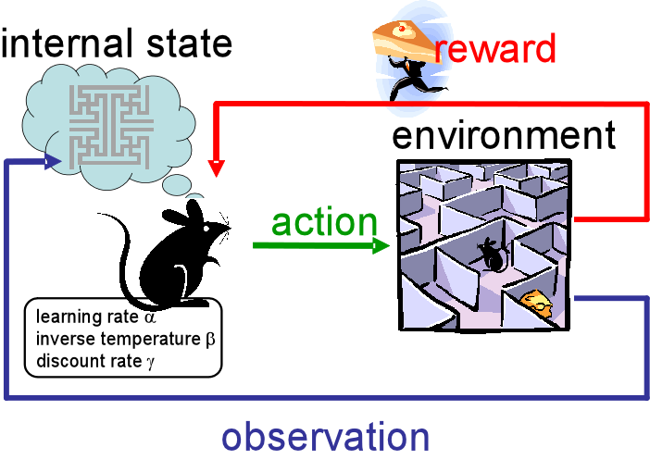
Reinforcement Learning
Application to decision making in pharmacy marketing.
Days of therapy
Patient True Needs
Decision Point: Email/Call
Our Model
Patients
Reinforcement learning is an area of machine learning concerned with how intelligent agents ought to take actions in an environment in order to maximize the notion of cumulative reward.
Patient attributes and status
Decision making in the pharmacy marketing is a continues process of producing optimal actions (decision points) to patients to gain the maximized overall reward (e.g. days of theropy). This is a typical reinforcement learning problem.

